Slide 1
Build Optimization of Fiber Reinforced 3D-Printed Components
Aaditya Chandrasekhar
University of Wisconsin- Madison
Prof. Krishnan Suresh
www.ersl.wisc.edu

Slide 2
Motivation – Anisotropy in Print

Slide 3
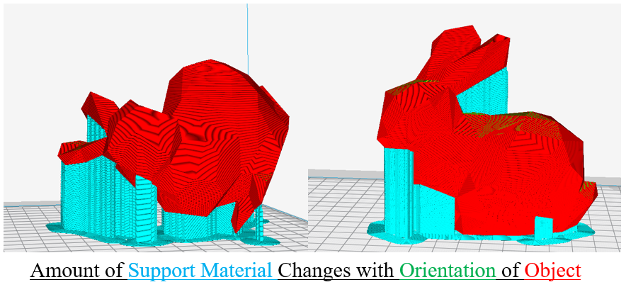
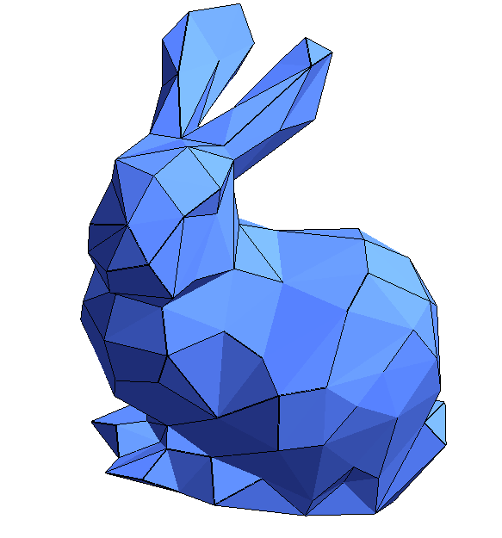
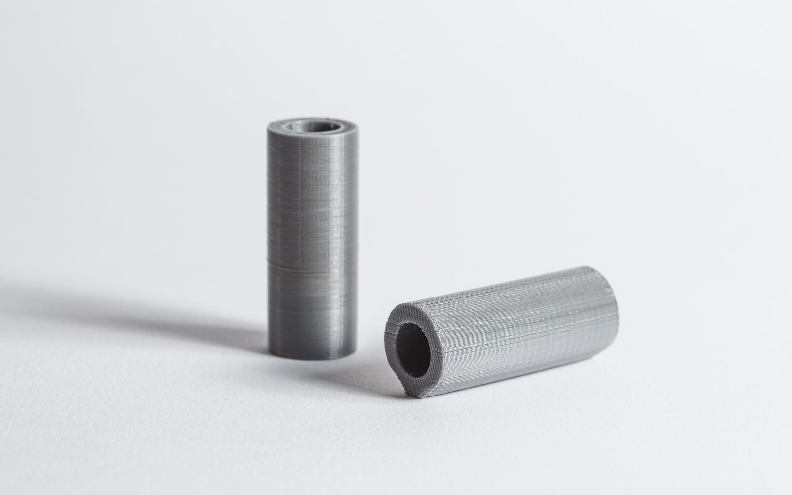
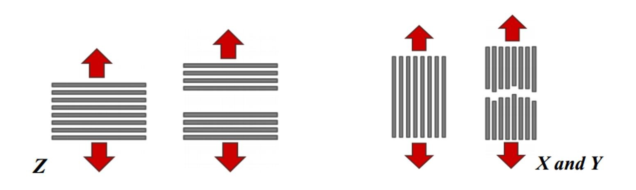
Build Orientation
Higher Surface Quality
Longer Print Time
Mechanical Performance
<
Thermal Loads

Slide 4
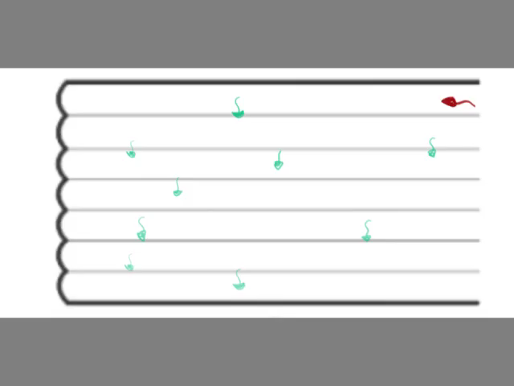
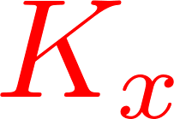
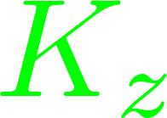
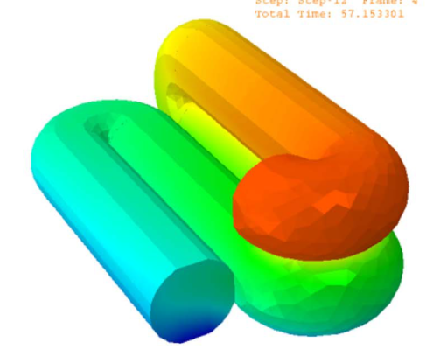
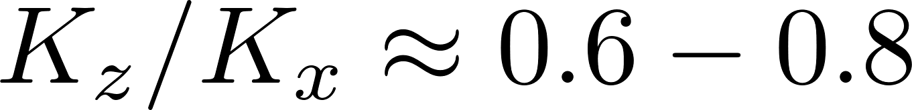
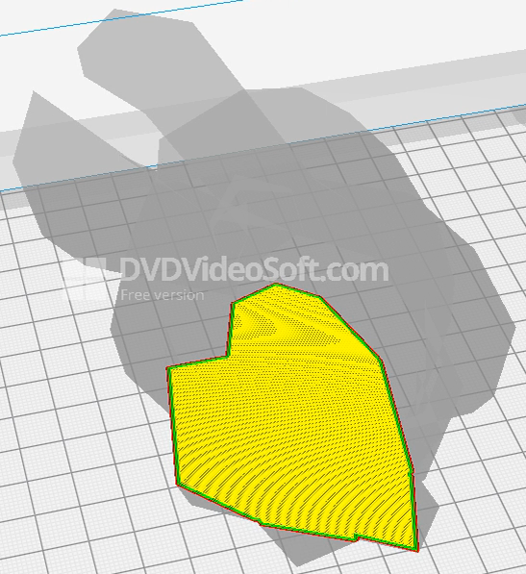
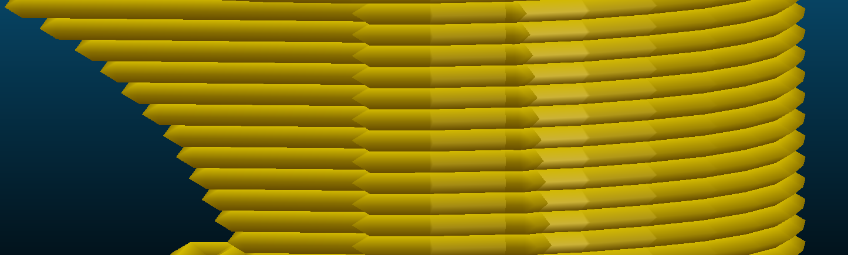
[1]
[2]
Melted New Layer
Print Orientation
Layer-wise manufacturing
Insufficient fusion
Interfacial Weak Bonding
Solidified Layer
[1] Prajapati H, Ravoori D, Woods RL, Jain A. Measurement of anisotropic thermal conductivity and inter-layer thermal contact resistance in polymer fused deposition modeling (FDM). Addit Manuf 2018;21:84–90. doi:10.1016/j.addma.2018.02.019.
[2] Brenken B, Barocio E, Favaloro A, Kunc V, Pipes RB. Fused filament fabrication of fiber-reinforced polymers: A review. Addit Manuf 2018;21:1–16. doi:10.1016/j.addma.2018.01.002.

Slide 5
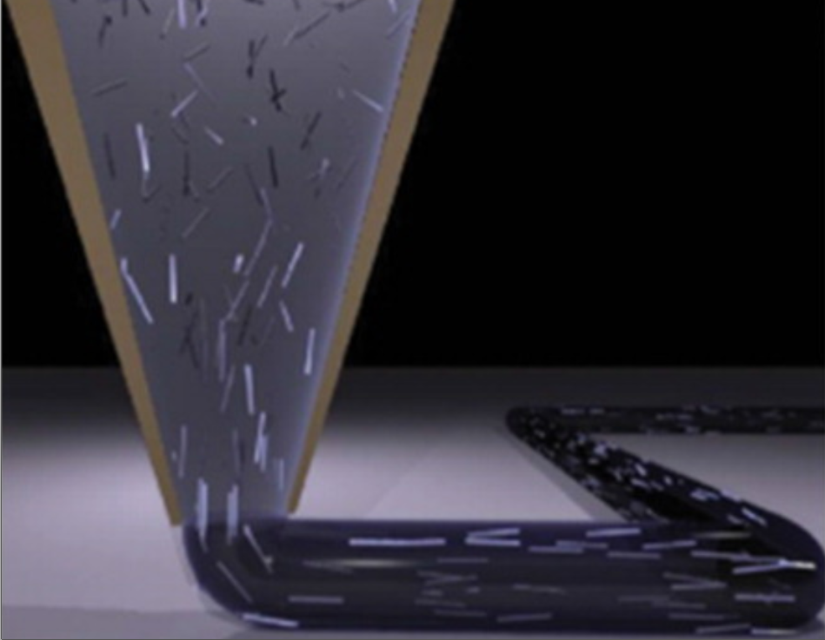
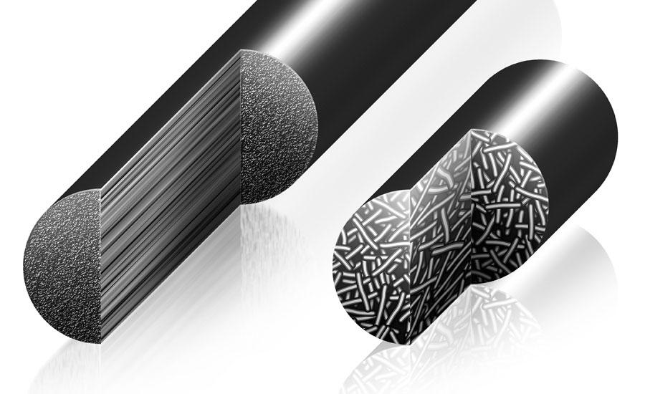
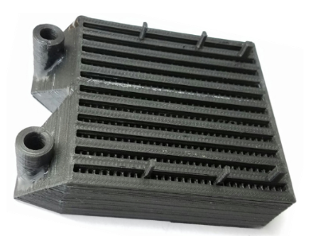
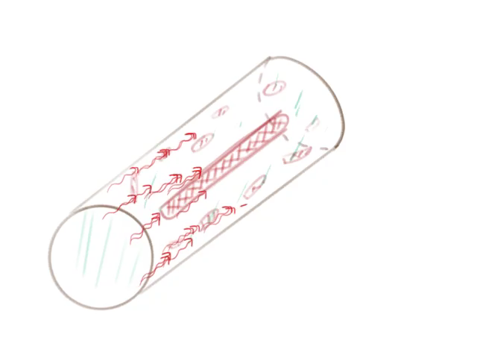
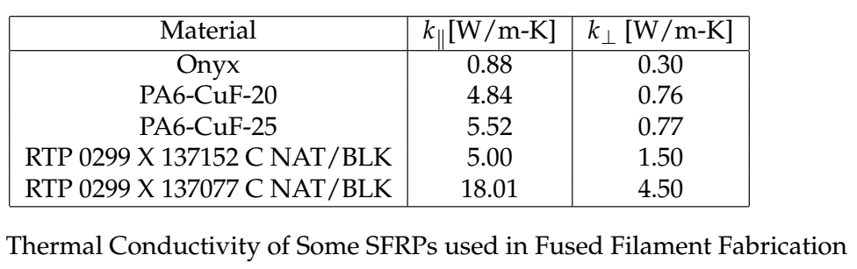
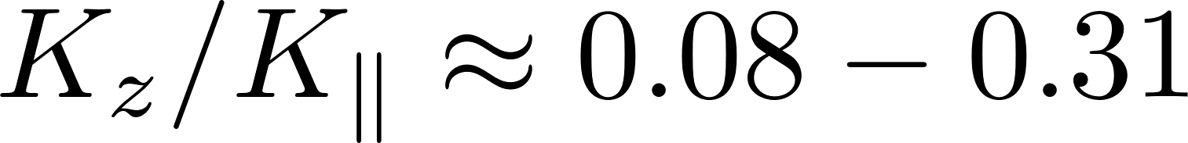
[1]
Short Fibers
Baseline : 0.26 W/m-K
Fiber filled composite
Short Fiber Reinforced
Better Mechanical Properties
Preferential orientation
Improved conductivity along fiber axis
[1] Zhang P, Liu J, To AC. Role of anisotropic properties on topology optimization of additive manufactured load bearing structures. Scr Mater 2017;135:148–52. doi:10.1016/j.scriptamat.2016.10.021.

Slide 6
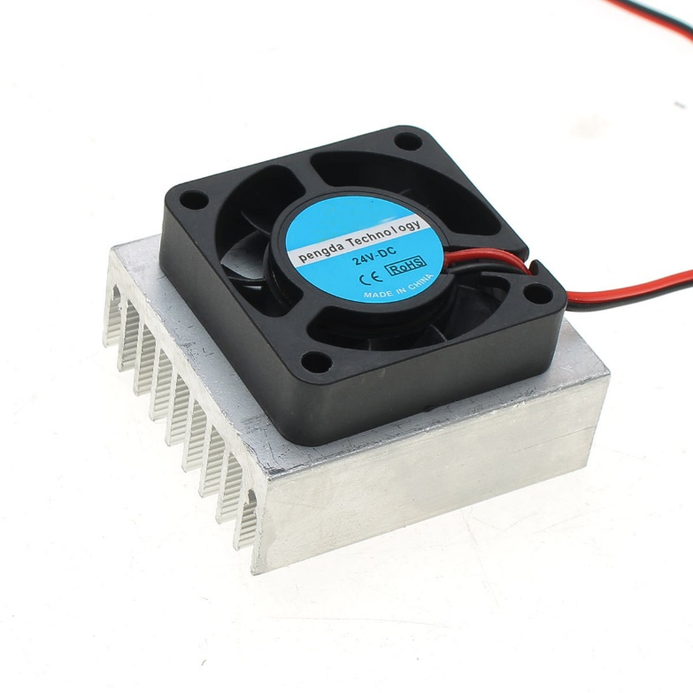
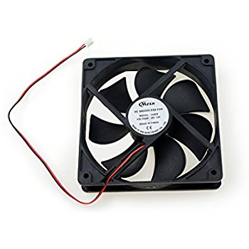
Electronic Cooling Mounts
Heat Exchangers
Cooling Fans
To produce highly optimized 3D printed objects

Slide 7
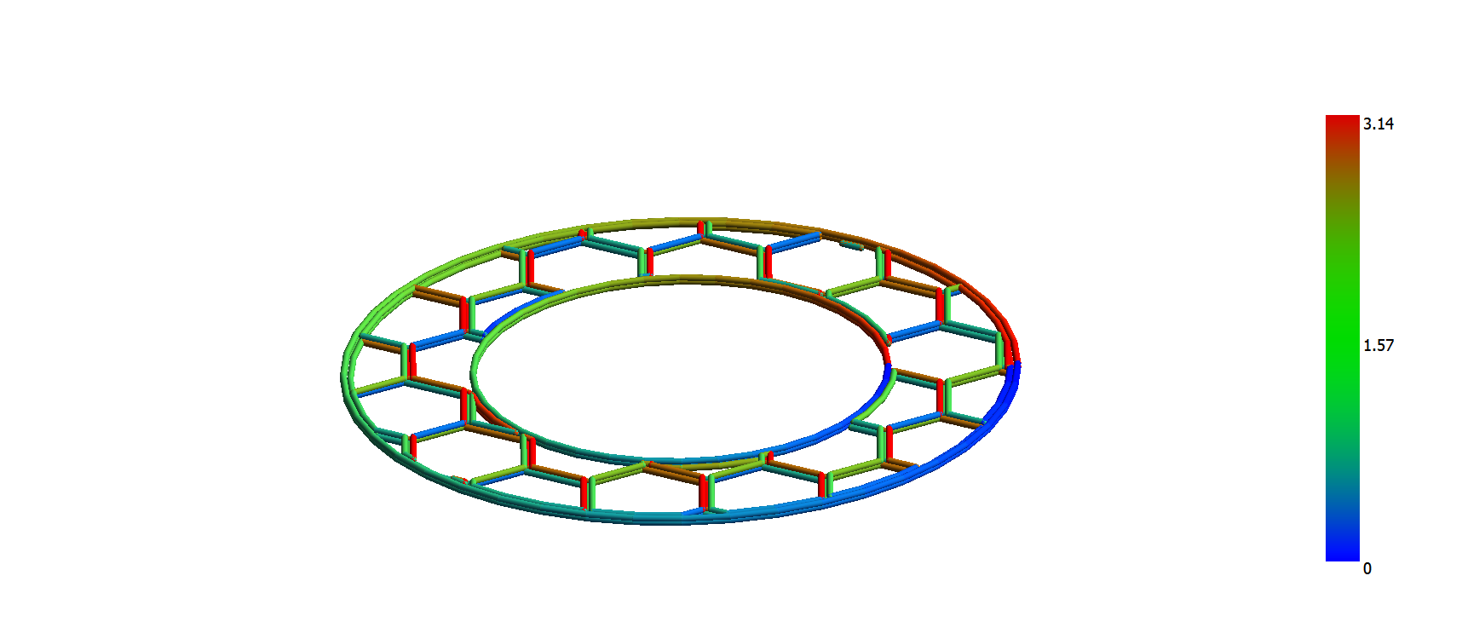
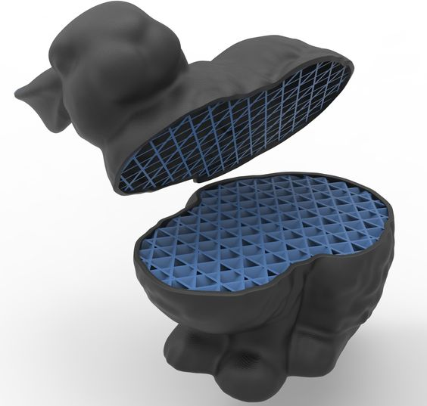
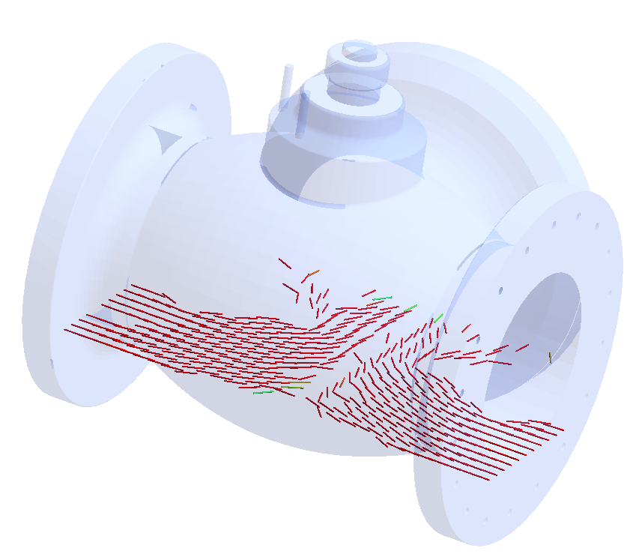
Infill Topology
Regular Pattern Infill
Optimized Infill Topology

Slide 8
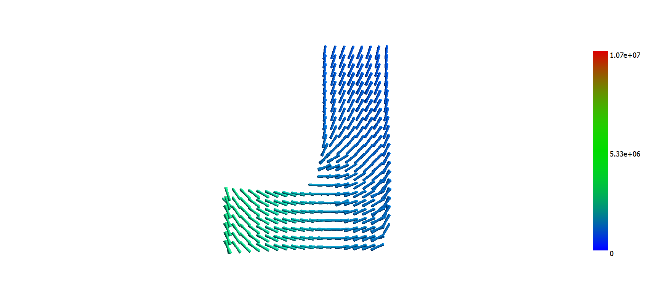
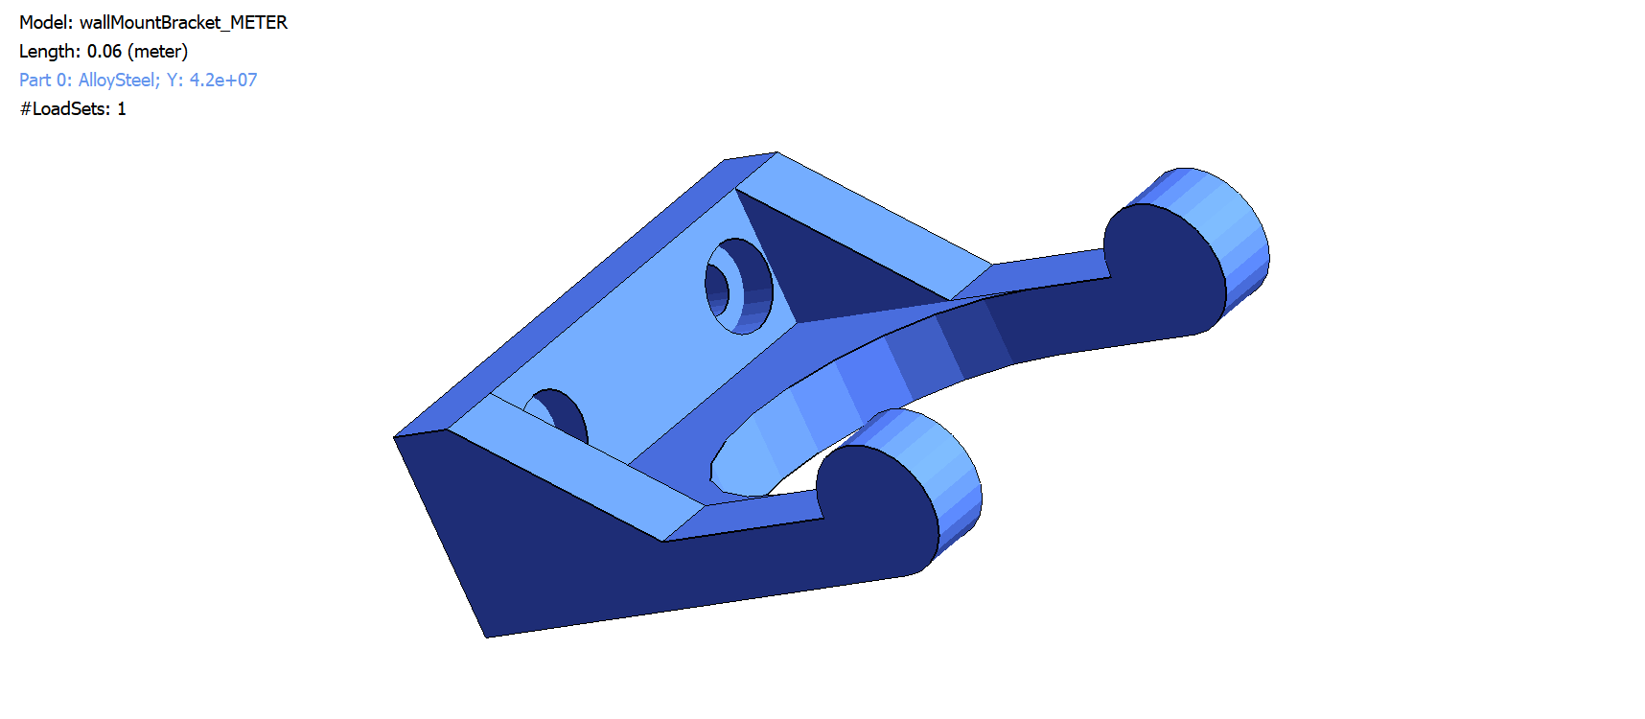
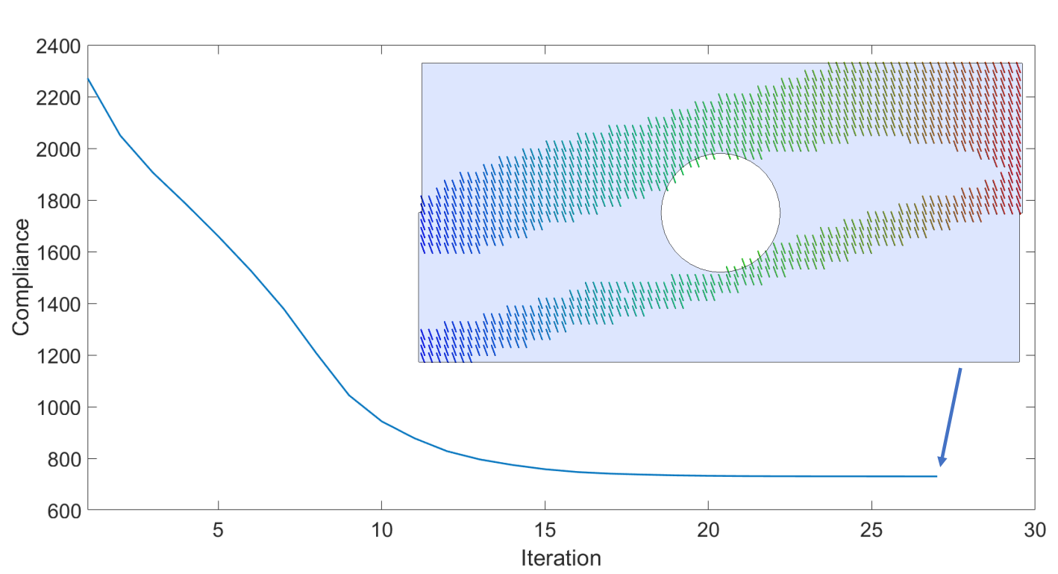
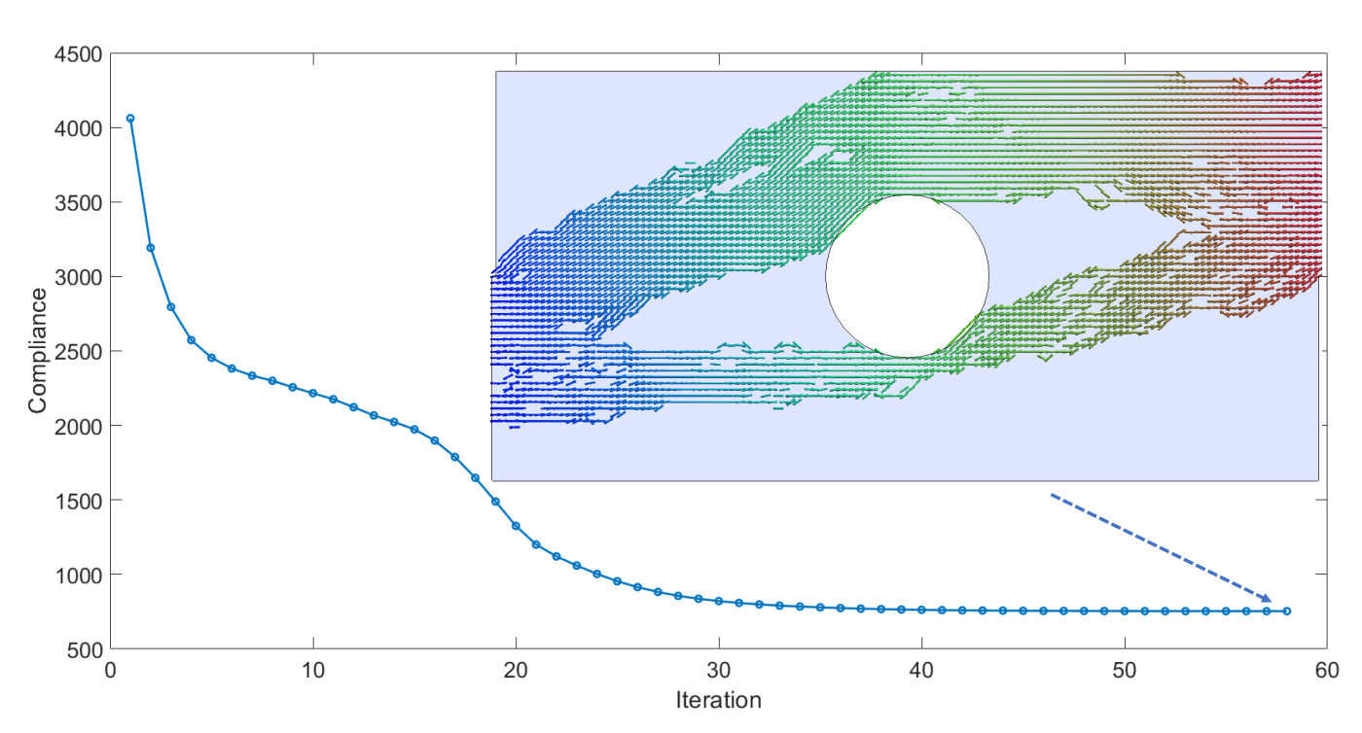
Heat Flux
Fixed Temperature
2. Infill Topology?
1. Build Direction ?
3. Fiber Orientation ?
Notes:
Mention infill 3 challenges infill fiber orientaiton

Slide 9
Optimization for structural performance in Literature
Literature | Build Orientation | Infill Topology | Fiber Orientation
Umetani [1] | * | - | -
Wu [2] | - | * | -
Stegmann [3] | - | - | *
Chandrasekhar*** | * | * | *
[1] Nobuyuki Umetani and Ryan Schmidt. Cross-sectional structural analysis for 3D printing optimization. In SIGGRAPH Asia 2013 Technical Briefs on - SA ’13, pages 1–4, New York, New York, USA, 2013. ACM Press
[2] Jun Wu, Niels Aage, Ruediger Westermann, and Ole Sigmund. Infill Optimization for Additive Manufacturing – Approaching Bone-like Porous Structures. IEEE Transactions on Visualization and Computer Graphics, 24(2):1127–1140, 2018
[3] J. Stegmann and E. Lund. Discrete material optimization of general composite shell structures. International Journal for Numerical Methods in Engineering, 62(14):2009–2027, Feb 2005
http://www.ersl.wisc.edu/publication.html
***Chandrasekhar, A., Kumar, T., Suresh, K., “Build Optimization of Fiber Reinforced 3D-Printed Components", Submitted to Struct Multidisc Optim, 2018.

Slide 10
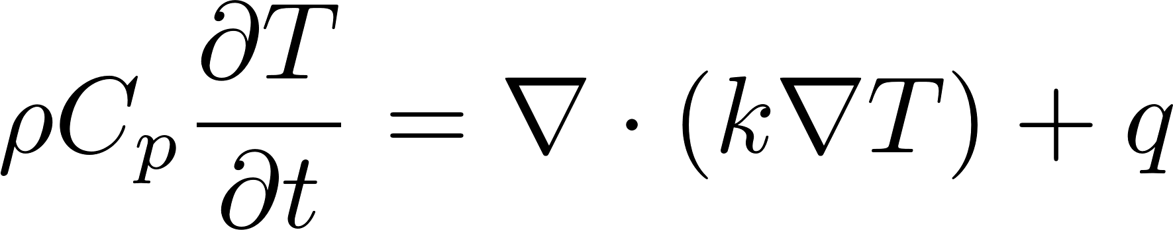
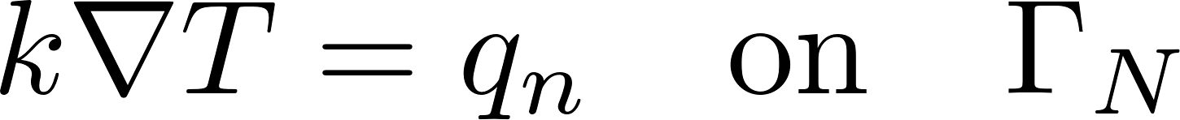
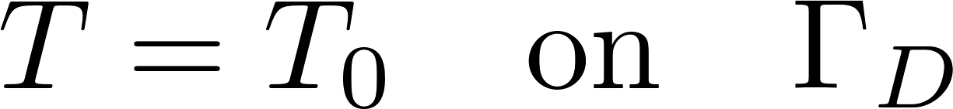
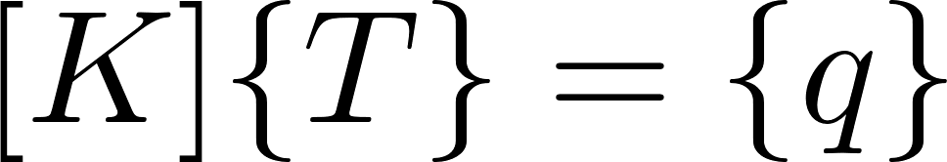
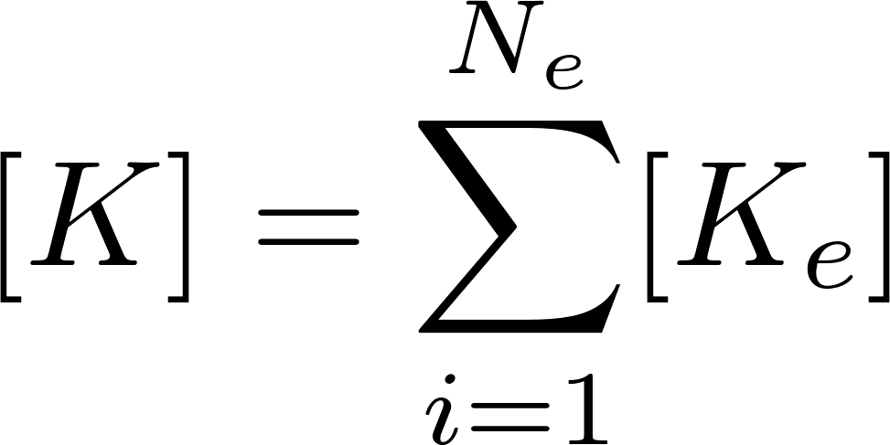
Thermal Analysis – A quick Review
Transient term
Heat Conduction
Internal Heat Gen.
Boundary Conditions.
Discretized FE Equations
Notes:
Fig back in here .. Thermakl problem …

Slide 11
Design parameters

Slide 12




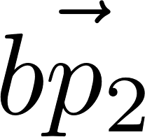
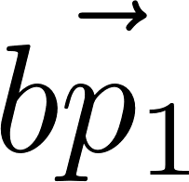
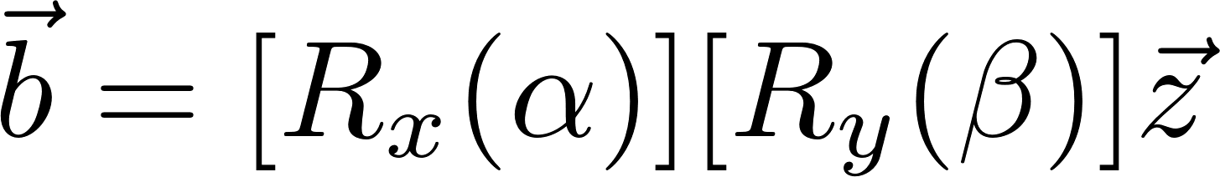
1. Build Orientation
Z
Y
X
Notes:
NUMBER 1 -> b dir

Slide 13


2. Infill Topology
1
0.75
.
.
.
Penalization
( SIMP )
{0,1}
0.0
Notes:
NUMBER 2 -> infill

Slide 14


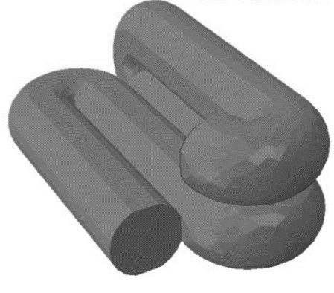
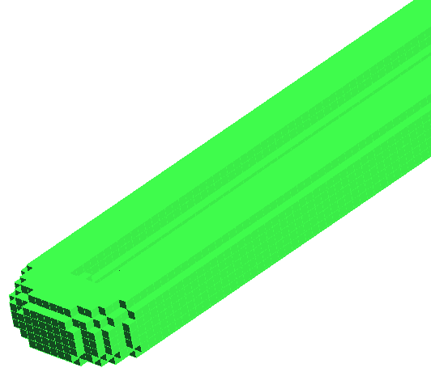

3. Fiber Orientation
How to lay material ?
Notes:
No need too many figures …. Where to put material -> how to put material -> same topology -> 2 different fiber orientation

Slide 15
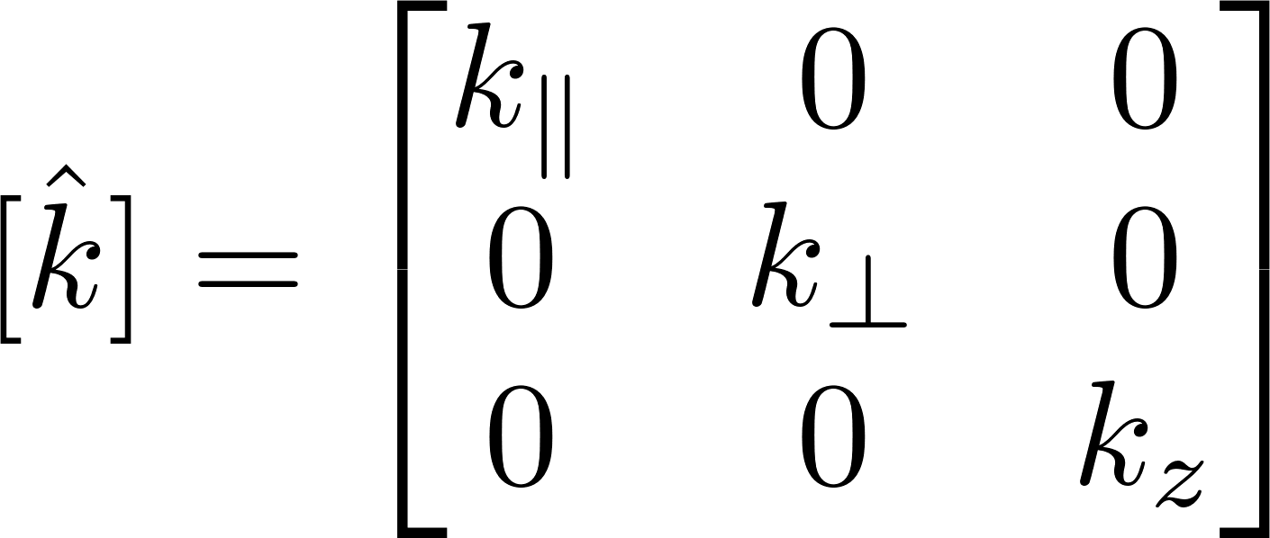
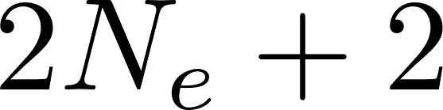
Fiber Infill
Build Orientation
Design Topology
D.O.F.
Element Stiffness
Notes:
INFILL TOPOLOGY

Slide 16
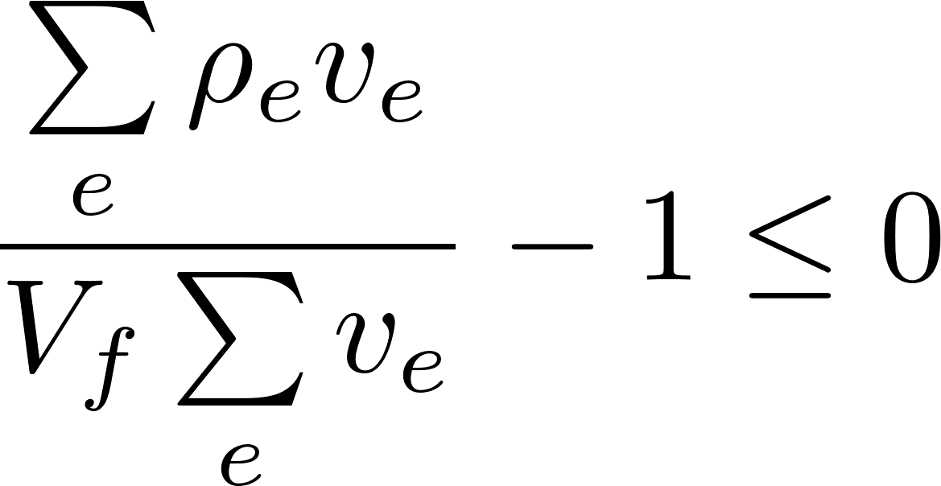
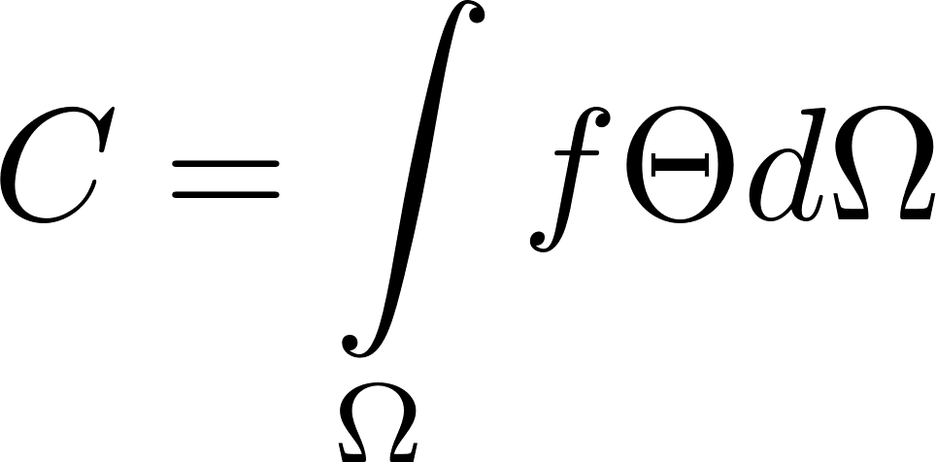
Optimization Formulation
Constraint : Global Volume
Objective Measure : Compliance
Governing Equation : Thermal F.E. Equation

Slide 17
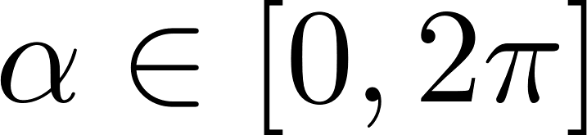
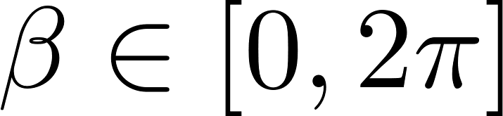
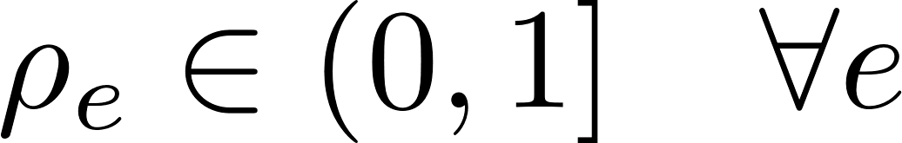
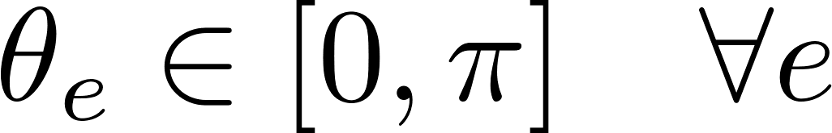
Variable Bounds
Build Orientation :
Infill Topology (element Density) :
Fiber Orientation :

Slide 18

Algorithm

Slide 19
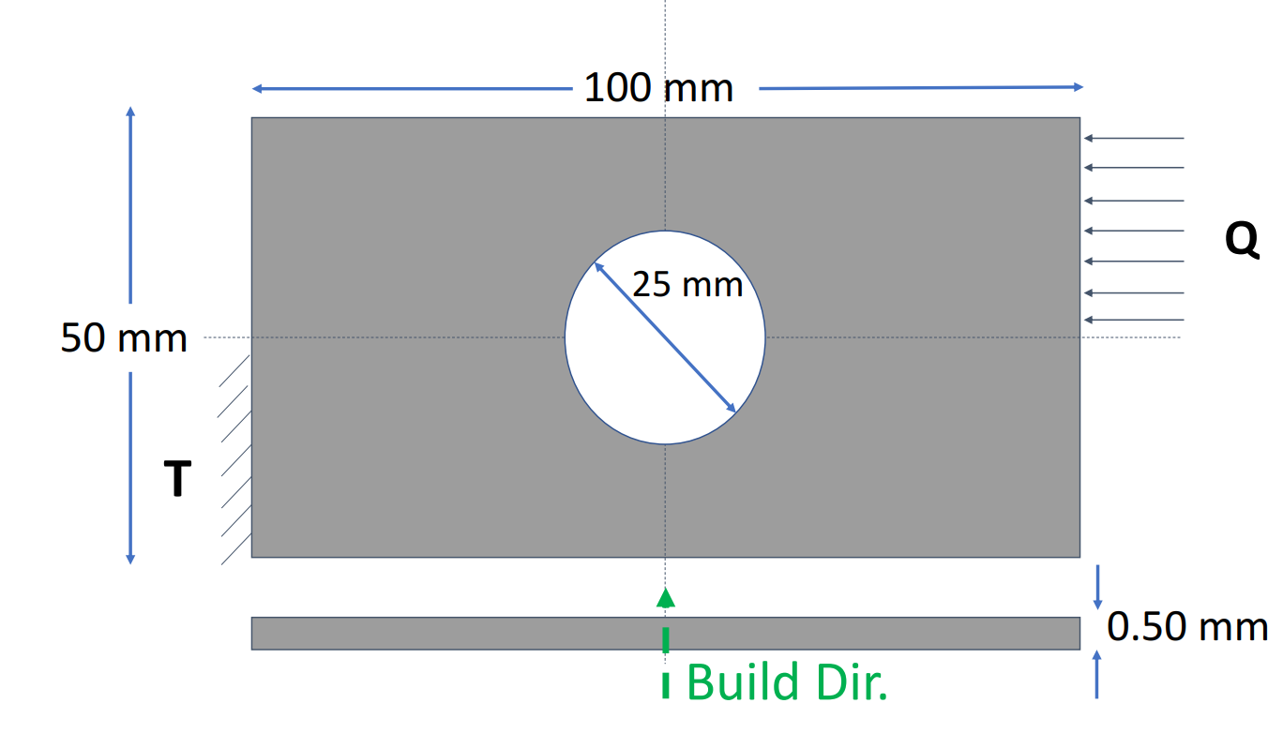
Results – Single Layer

Slide 20
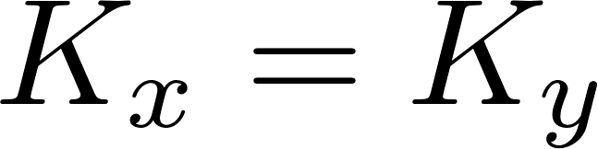
Infill Optimization
Attribute | Value
Num Elem. | 1e5
Final Vol. Fraction | 0.50
Num Iteration | 27
Total Time (min) | 6
Cf/C0 | 0.28

Slide 21
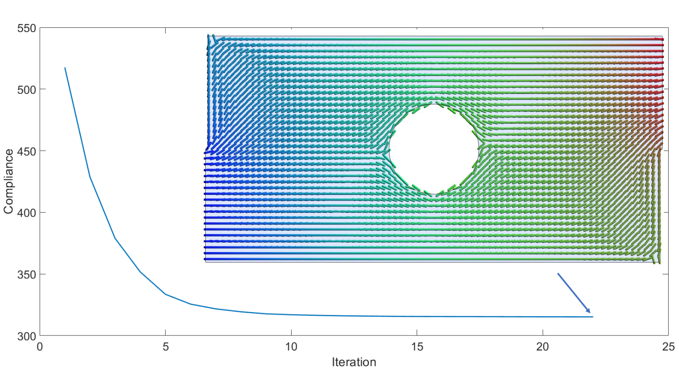
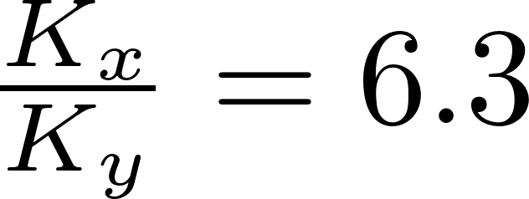
Fiber Orientation Optimization
Attribute | Value
Num Elem. | 1e5
Final Vol. Fraction | 0.5
Num Iteration | 32
Total Time (min) | 23
Cf/C0 | 0.31

Slide 22
Fiber Orientation + Infill Topology Optimization
Attribute | Value
Num Elem. | 1e5
Final Vol. Fraction | 0.5
Num Iteration | 57
Total Time (min) | 38
Cf/C0 | 0.10

Slide 23
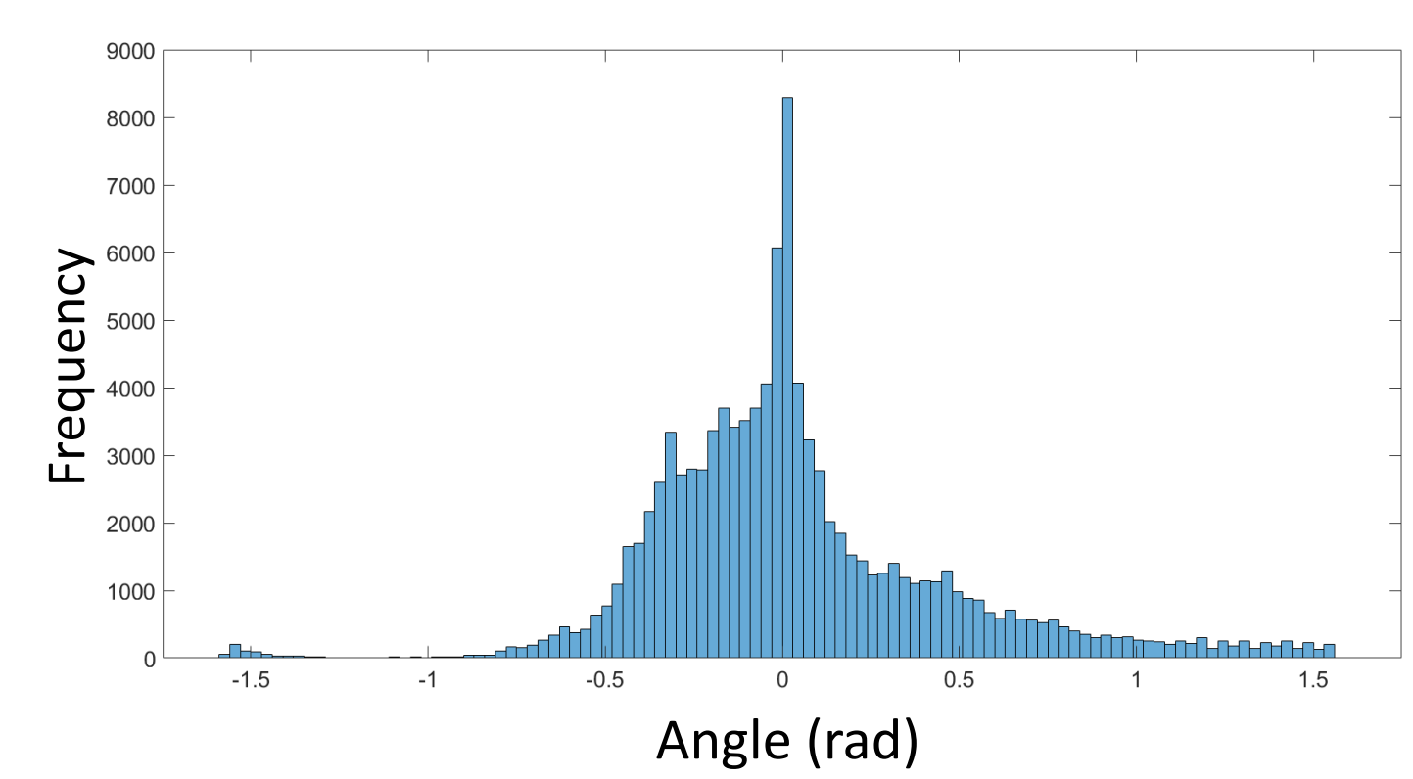
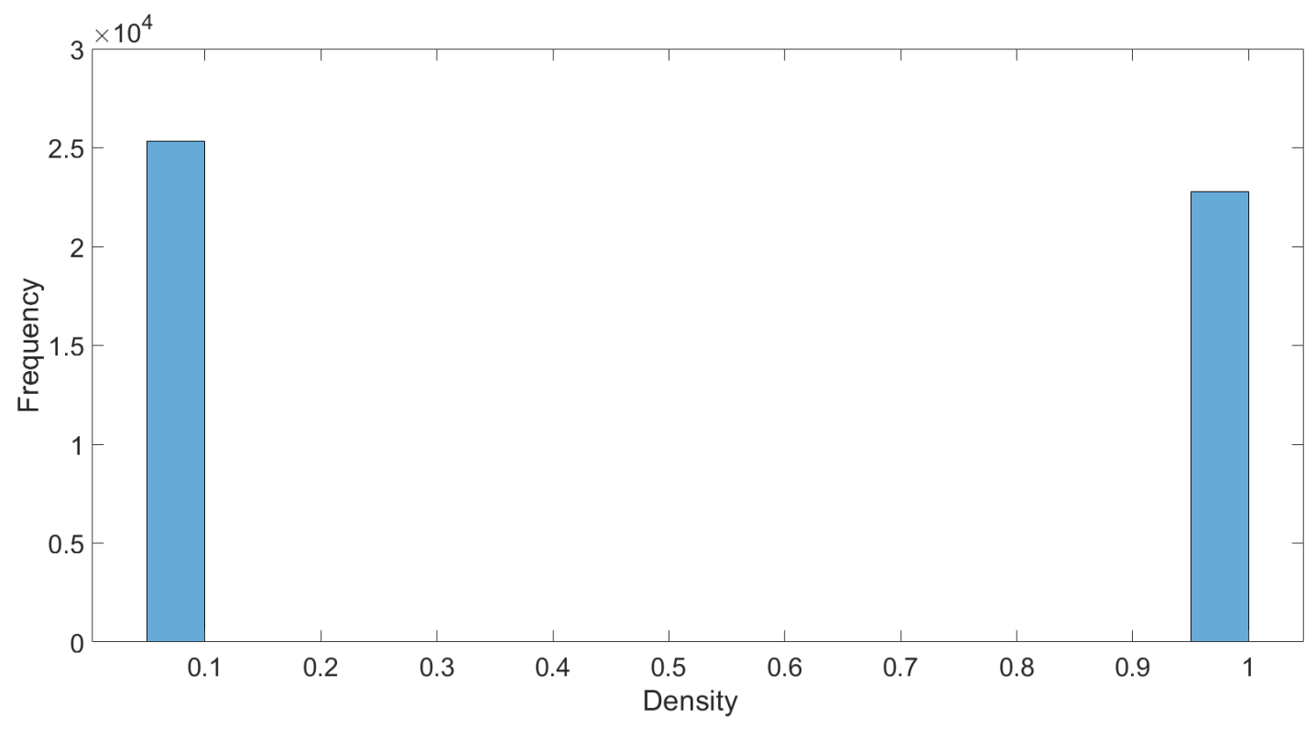
Distribution

Slide 24


3D Optimization

Slide 25


Slide 26

Complex Geometry

Slide 27

Attribute | Value
Num Elem. | 5e4
Num Iteration | 80
Total Time (min) | 75
Cf/C0 | 0.05

Slide 28
Conclusion
Framework to optimize Infill, Build orientation and Topology.
Reasonable computation time
Presented for thermal loads. Extendable for structural
Support requirement ?
Generate G-Code from mesh-instructions ?
Experimental validation.

Slide 29
Questions ?
Prof. Krishnan Suresh
Director : Engineering Representation and Simulation Lab (ERSL)
UW-Madison
http://www.ersl.wisc.edu/publication.html
Chandrasekhar, A., Kumar, T., Suresh, K., “Build Optimization of Fiber Reinforced 3D-Printed Components", Submitted to Struct Multidisc Optim, 2018.

Slide 30

Congruent voxel mesh
Thermal Loading
Build Orientation ?
Infill Topology ?
Infill Pattern ?

Slide 31







Initial Design

